Slide 1
Code Switching Project
1
Keith & Arav

Slide 2
Final Dataset
2
Number of Dialogues: 798
Total utterances: 6,083
Total tokens: 125,048
Distinct tokens: 3,143
Mixed Utterance Rate: 28.69%
Attributes in Each Record:
"Id" - Unique identifier for each record
"Utterance" - Dialogue generated
"Source" - “LLM”
"Generation_strategy" - List of which generation strategies we used (few shot, chain of thought, persona)
"Model_name" - GPT model that we used ("gpt-3.5-turbo", "gpt-3.5-turbo-16k", "gpt-4o-mini")
"prompt_text" - actual prompt inputted into the model

Slide 3
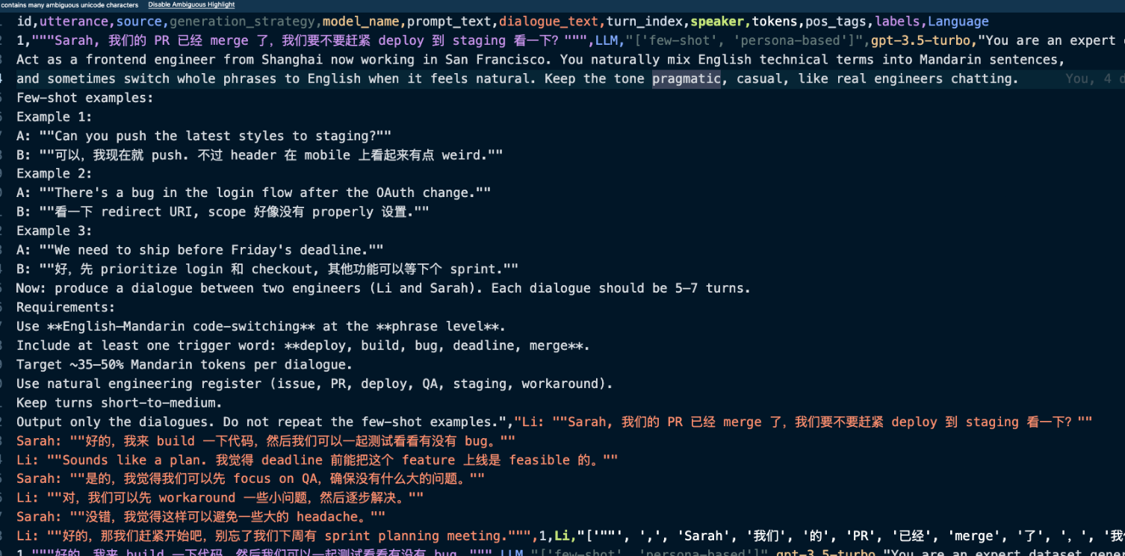
Processed Dataset
3
id: unique identifier
utterance: one utterance / sentence spoken by a speaker
Source: “LLM”
generation_strategy: LLM prompting strategy used
model_name: model variant used for generation
dialogue_text: the full dialogue text returned from the LLM
turn_index: unique identifier within a dialogue that represents the n-th turn of an utterance
speaker: the speaker in the dialogue
tokens: tokenized representation of each utterance
pos_tags: part-of-speech tags (via spaCy and jieba for English and Mandarin POS tagging)
Labels: a set of languages used in this dialogue
Language: a list that shows what language every token is in

Slide 4
POS Extraction and Tokenization
4
Clean the input
Remove extra spaces and trim the text.
Check for Chinese characters (CJK)
Use a regular expression (Regex) to see if the text contains any Chinese characters.
If the text contains both English and Chinese:
Add spaces around English words and numbers to separate them from Chinese text.
Split the text into parts (Chinese runs, English words, numbers, and punctuation) using Regex.
Group consecutive English words together and process them with spaCy to get tokens, POS tags, lemmas, and dependencies.
Use jieba.posseg to split Chinese text and get tokens with their POS tags.
Treat numbers and punctuation as individual tokens with simple tags.
If the text is pure English:
Run spaCy on the entire sentence for tokenization and linguistic features.
For each token, create a dictionary that includes TurnID, Token text, Language, POS, etc
Return a list of these token dictionaries

Slide 5
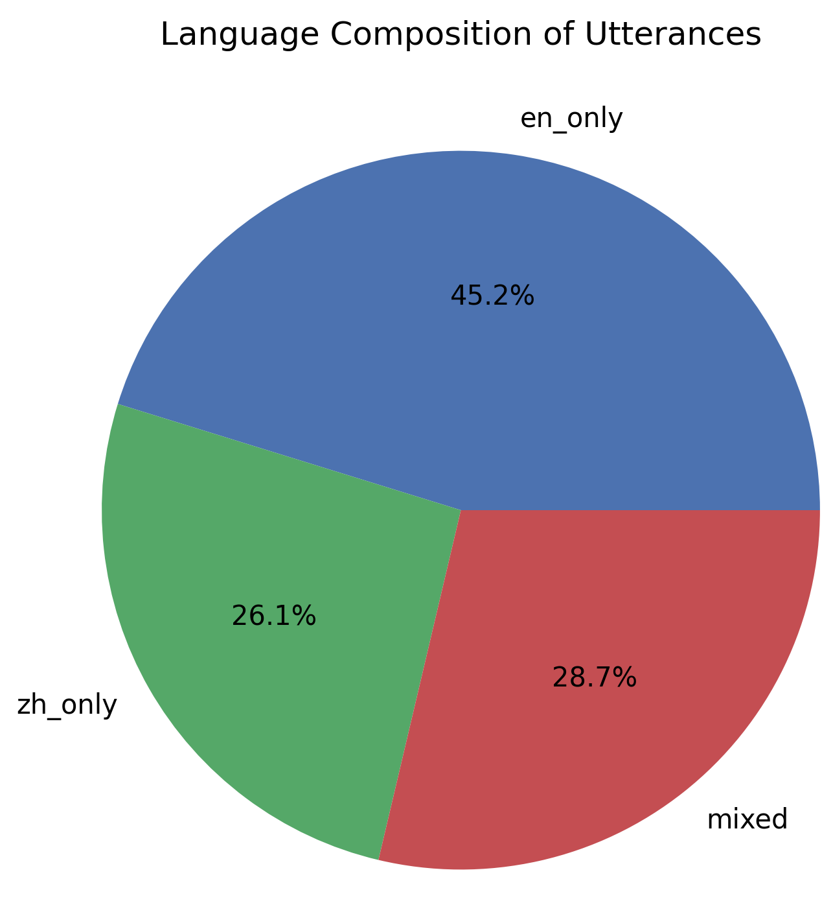
Language Composition in Utterances
5
English-only utterances dominate at 45.2%, followed by mixed utterances at 28.7%, and Chinese-only at 26.1%, providing diverse training data for code-switch modeling
This falls within the desired 20-30% range and aligns with real-world bilingual code-switching patterns observed in datasets like ASCEND
Nearly one-third of utterances contain language mixing, providing around 1,750 examples of switches for training predictive models
The composition mirrors natural English-Mandarin technical conversations where English dominates but code-switching frequently occurs for technical terms and contextual nuance

Slide 6
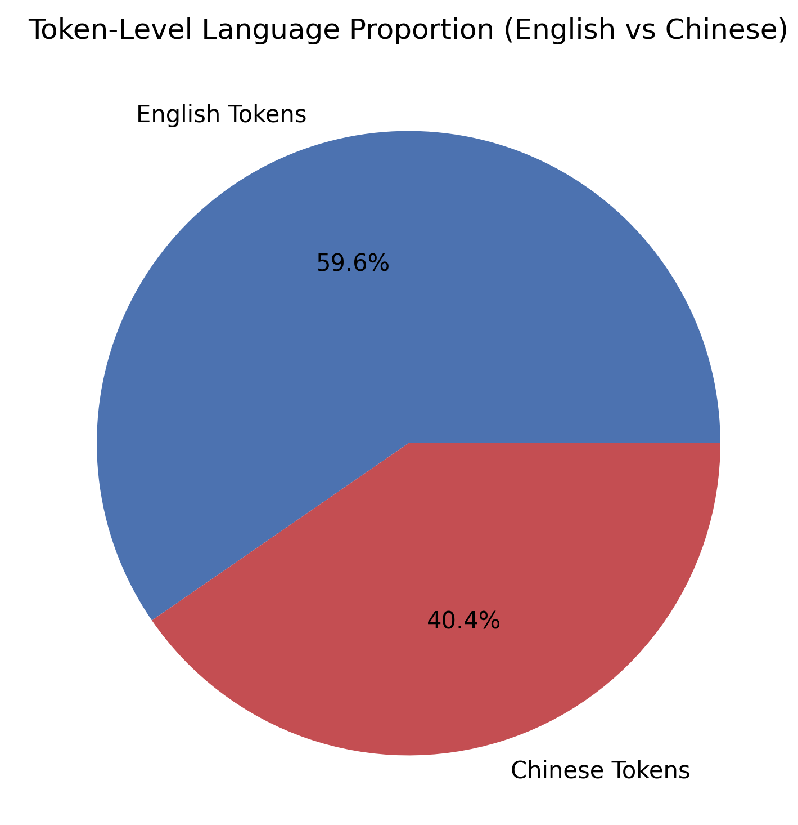
Token-Level Language Proportion
6
English tokens comprise 59.6% while Chinese tokens make up 40.4% of the dataset, providing a well-balanced bilingual corpus with 125,048 total tokens
The 60-40 split aligns with English-Mandarin code-switching patterns in technical/professional settings where English often serves as the matrix language
With around 74,500 English tokens and 50,500 Chinese tokens, both languages have adequate samples for training robust multilingual models without too much class imbalance
The relatively even split ensures predictive models can learn meaningful patterns for switches in both directions

Slide 7
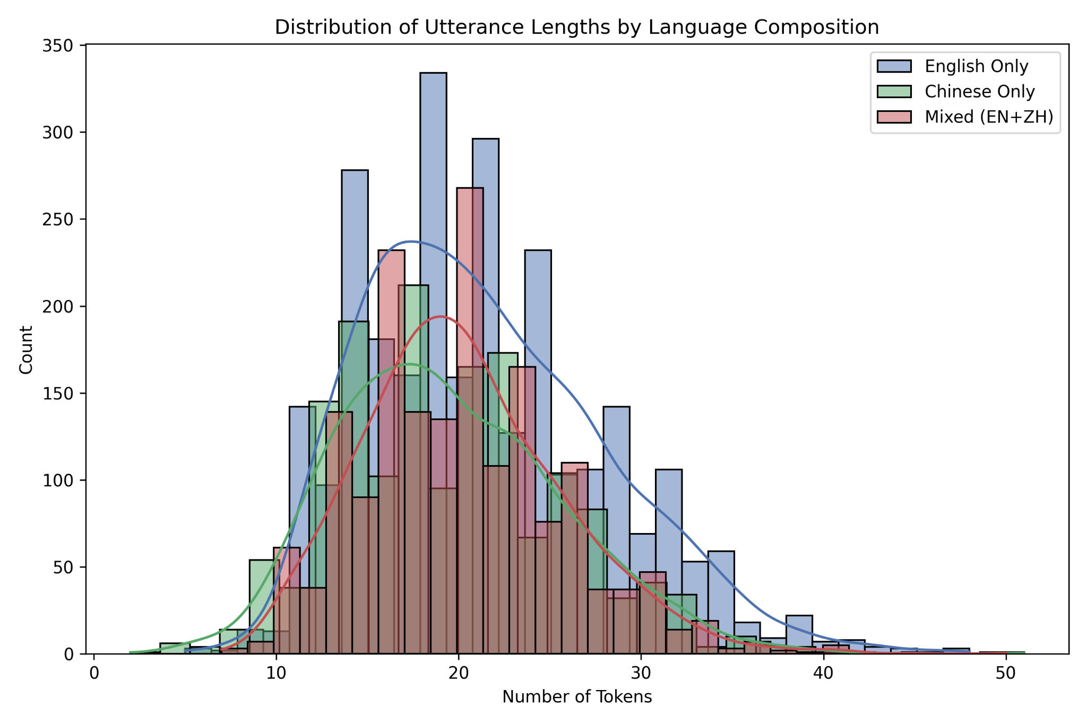
Distribution of Utterance Length
7
Most utterances range between 15–30 tokens, representing typical conversational or task-focused exchanges.
Short utterances (under 10 tokens) are quick acknowledgments or brief replies (ex: “Sure,” “Okay”), while long utterances (over 30 tokens) correspond to detailed explanations or multi-sentence instructions.
The distribution shapes indicate that English utterances are generally longer, Chinese ones are more concise, and mixed utterances fall in between.

Slide 8
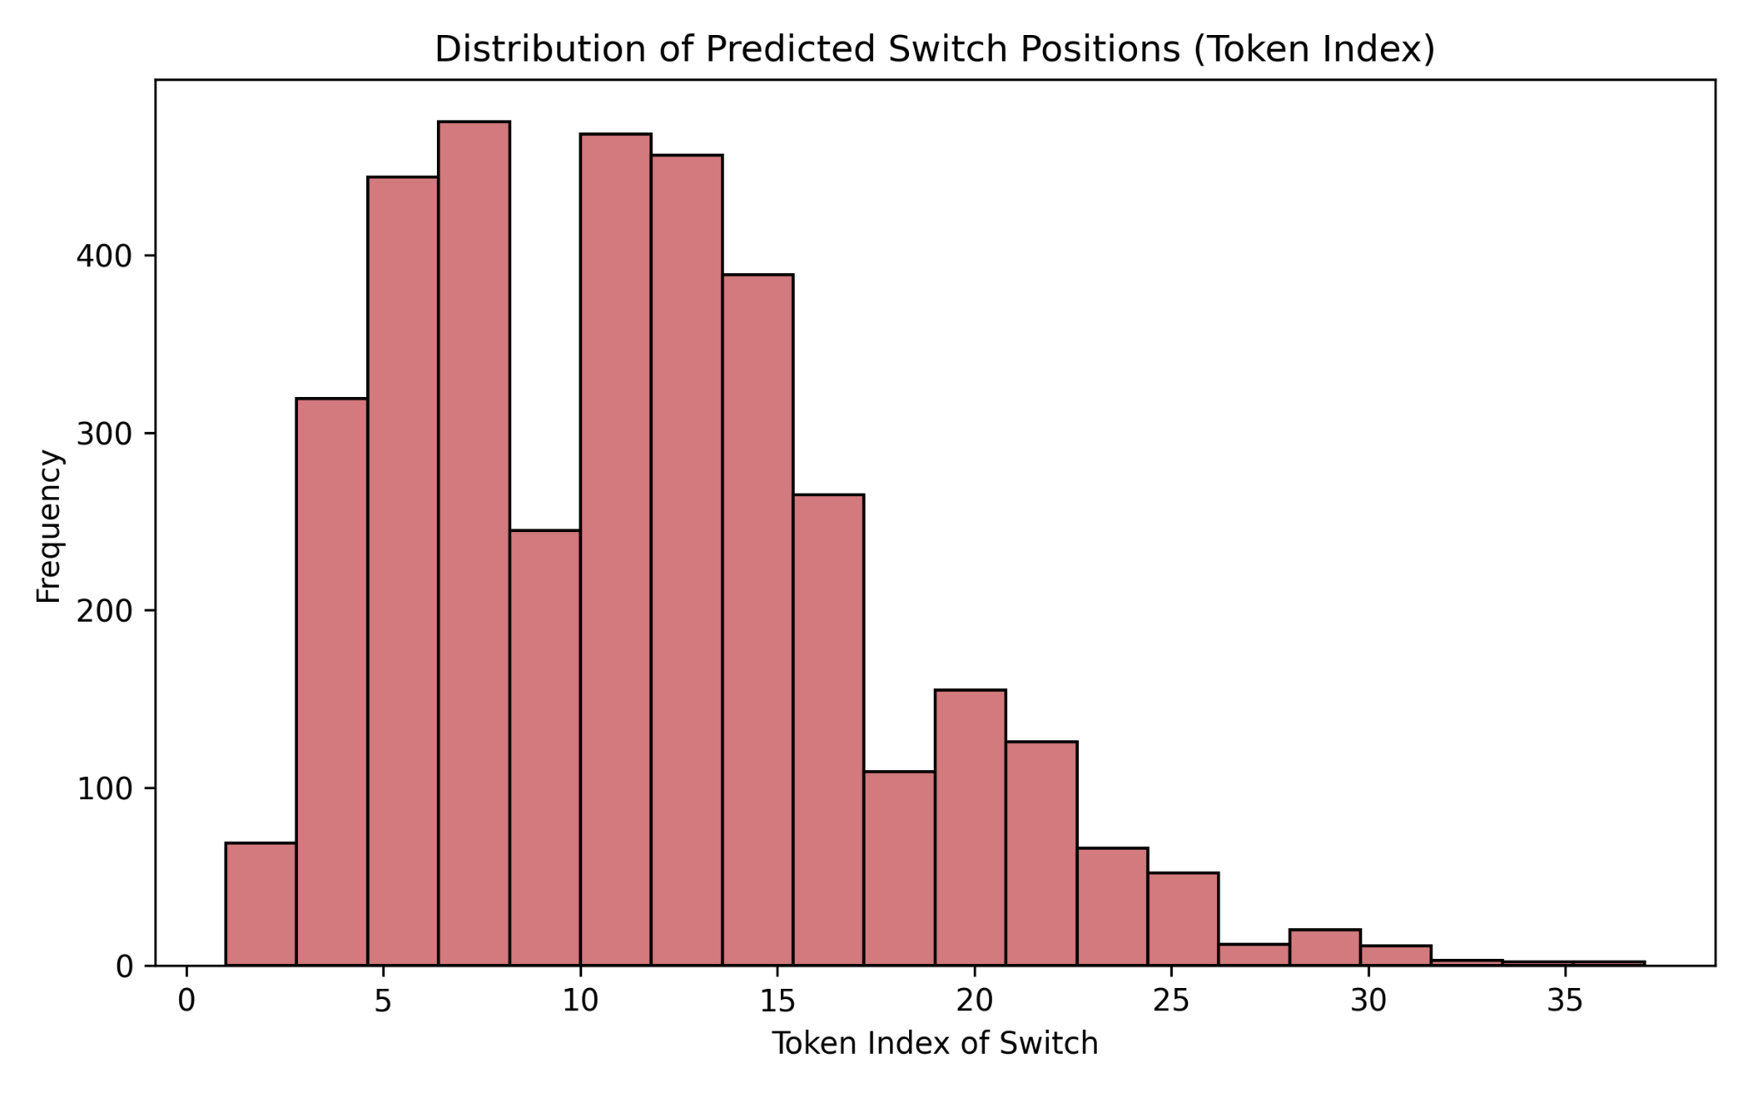
Distribution of Predicted Switch Positions
8
Code-switches occur predominantly at token indices 5-15, with peak frequency around indices 6-8, indicating speakers typically switch languages early in utterances.
Switch frequency drops significantly after the mid-utterance point, suggesting once speakers commit to a language beyond ~15 tokens, they maintain it for the rest of the utterance
The long tail extending to indices 30-35 shows late switches are possible but uncommon, likely occurring only in complex multi-clause sentences or detailed explanations
Token position should be a valuable predictive feature, as early tokens carry stronger contextual cues for switches while later positions may require deeper syntactic understanding

Slide 9
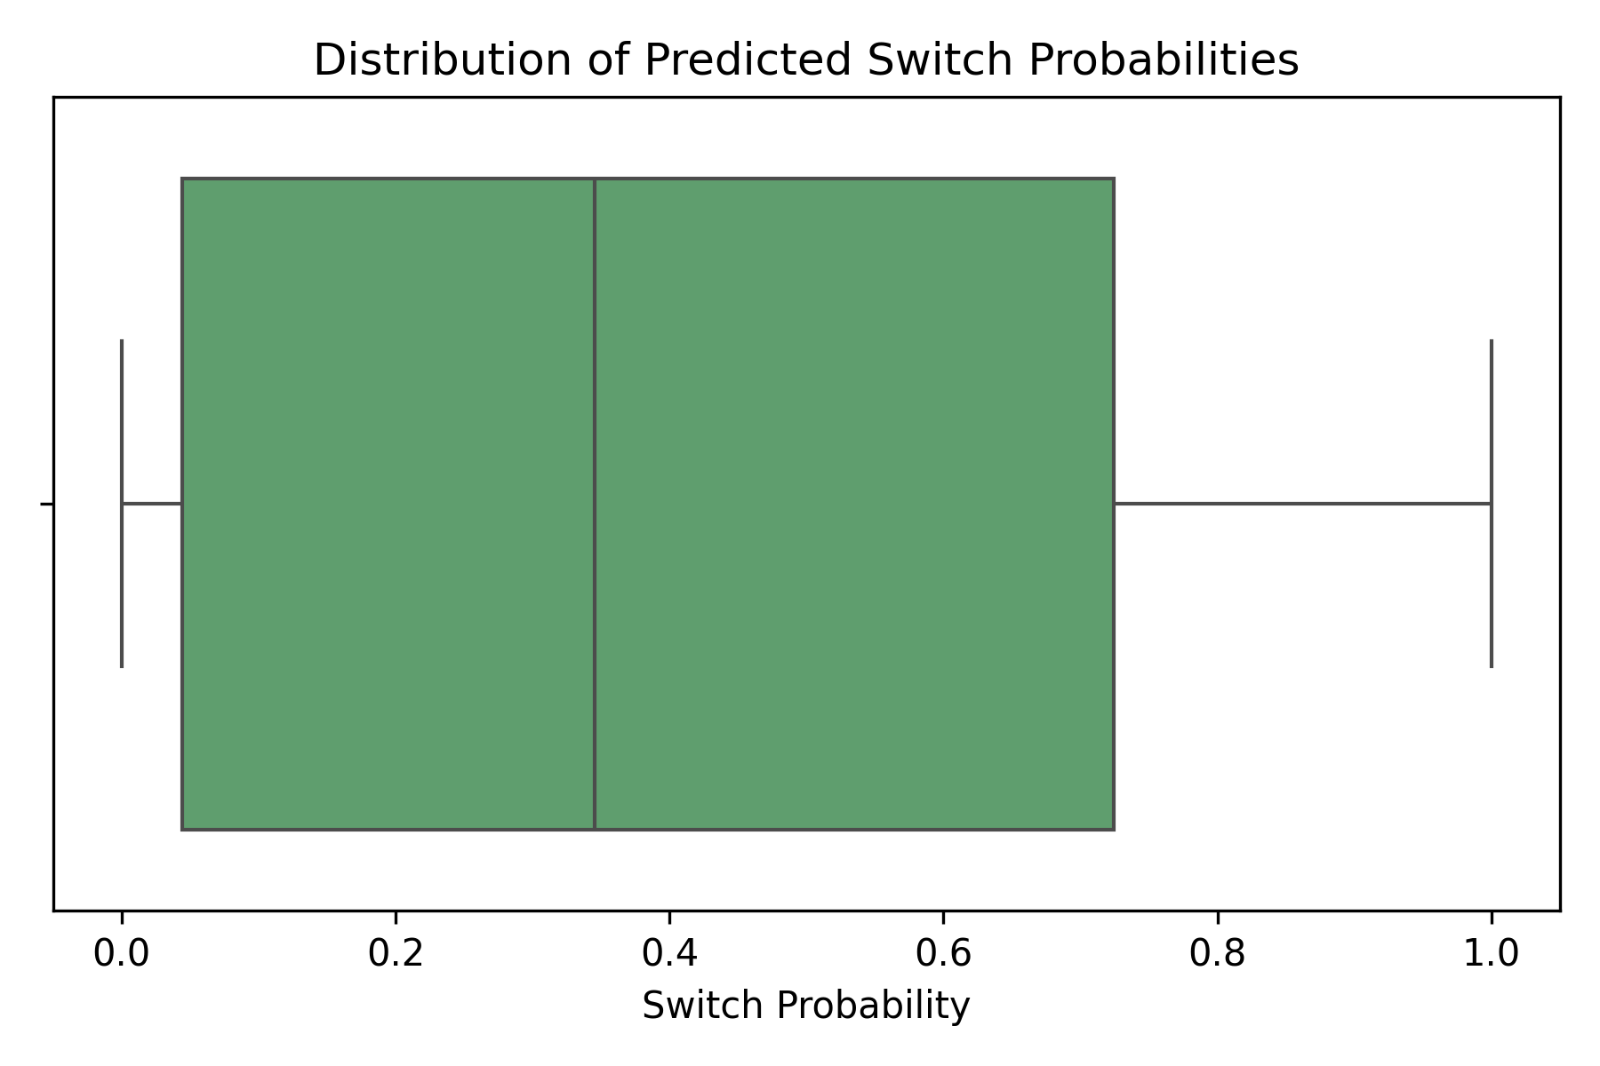
Distribution of Predicted Switch Probabilities
9
50% of predictions fall below 35% switch probability, with only the top 25% exceeding 70%, indicating the model is appropriately conservative about predicting switches.
The interquartile range spanning 5%-70% captures the difficulty in code-switch prediction, explaining why the model achieves high recall (~78%) but moderate precision (~65%)

Slide 10
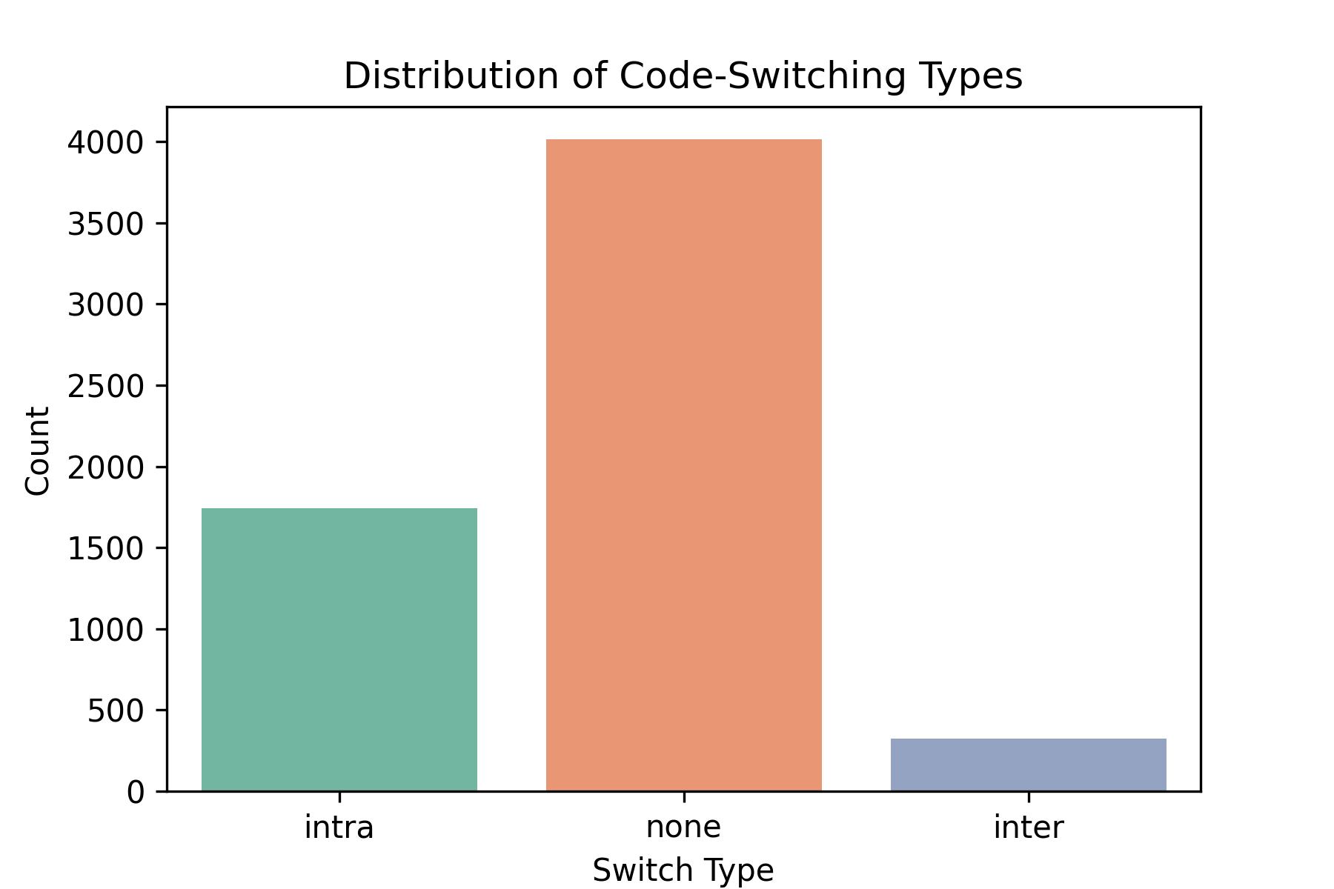
Distribution of Code-switch Types
10
1,750 intra-sentential switches (within utterances) significantly outnumber 350 inter-sentential switches (between utterances), reflecting natural code-switching patterns in technical dialogue.
This aligns with bilingual speakers switching to English technical terms (like PR, bugs, commits, staging) after Chinese sentences, rather than alternating languages between complete utterances.
With 4,000 "none" cases, the dataset maintains realistic class distribution where most tokens don't trigger language switches, which explains model behavior and the need for balanced precision-recall optimization

Slide 11
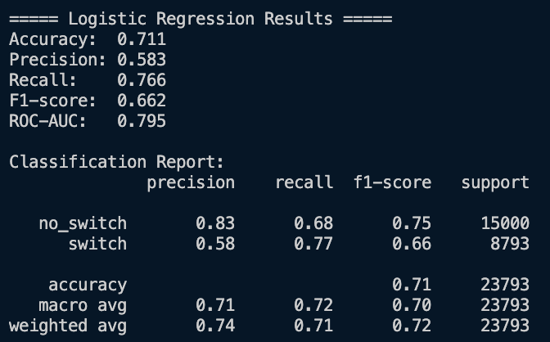
Logistic Regression Results
11
The model tends to favor recall over precision for the “switch” class, meaning it’s better at finding switches than being sure about them (we often “overpredict” on number of switches).
This tradeoff can be acceptable if missing a switch is more costly than falsely labeling one.
For No-Switch: High precision means that when the model predicts no switch, it’s usually right. However, recall is lower, meaning some “no switch” cases are misclassified as switches.
For Switch: High recall but lower precision means that the model catches most switches but often overpredicts them, leading to false positives.
Improving strategies could include:
Using class weights or resampling to balance training data.
Incorporating contextual features (ex: previous utterances, speaker turns).
Trying sequence models like BiLSTM or Transformers to capture dependencies across tokens and improve discrimination.

Slide 12
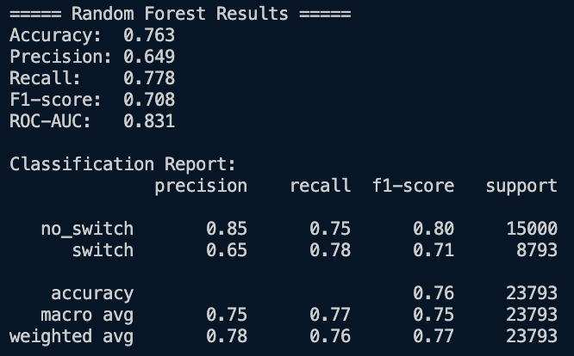
Random Forest Results
12
The Random Forest outperforms Logistic Regression across all metrics, especially in F1-score and ROC-AUC
The model has a strong ability to detect switches (high recall) while also becoming more precise, reducing false positives.
This suggests that Random Forest is capturing nonlinear relationships and feature interactions better than the linear logistic model.
Very reliable at predicting “no switch”: high precision and solid recall. Some “no switch” utterances are still misclassified as switches, but overall performance is strong.
Improved compared to logistic regression for “switch” predictions”: maintains high recall while increasing precision, meaning fewer false alarms for switch cases.

Slide 13
Next Steps
13
Why our model wasn’t as successful
The baseline model relied on static text representations like bag-of-words or TF-IDF, which failed to capture sequential dependencies between tokens.
It also lacked contextual understanding of how English and Mandarin tokens interact within a sentence.
Deep Learning Model
Bidirectional LSTM (BiLSTM) and Transformer architectures can capture word order and temporal relationships across tokens (context and sequence)
We will train these models on sequence-labeled data, allowing them to recognize patterns that precede or follow code-switches, such as topic changes, function words, etc.
Some other features we can add are: contextual embedding, pre-trained word embeddings from Word2Vec/FastText, character level embedding, and maybe even speaker/dialogue turn id.
Expected performance improvements and additional benefits
Increase in recall due to better temporal modeling.
F1-score improvement, which should surpass our current benchmark of 0.85.
Enhanced interpretability, offering deeper insights into linguistic and contextual factors that influence code-switching behavior.

